Slide 1

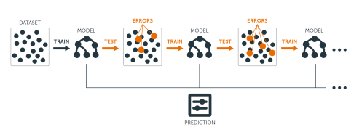

Gradient Boosting: Powering Machine Learning
Gradient boosting is a powerful ensemble learning technique that combines multiple weak models, such as decision trees, to create a strong predictive model. It iteratively adds new models to correct the errors of the previous models, resulting in highly accurate predictions.
by Praveen kumar T G

Slide 2
How Gradient Boosting Works
1
Weak Learners
Gradient boosting starts by training a simple, weak learner, such as a decision tree with just a few levels.
2
Residual Errors
The weak learner is then used to make predictions, and the residual errors (the difference between the true values and the predicted values) are calculated.
3
Iterative Improvement
A new weak learner is then trained to predict the residual errors, and the two models are combined to make more accurate predictions.

Slide 3
Advantages of Gradient Boosting
1
High Accuracy
2
Handles Complex Relationships
Gradient boosting can achieve state-of-the-art performance on a wide range of machine learning tasks.
The model can capture complex, nonlinear relationships in the data through the use of decision trees.
3
Robust to Overfitting
4
Versatile
Gradient boosting is less prone to overfitting compared to other ensemble methods, such as bagging.
Gradient boosting can be used for classification, regression, and ranking problems.

Slide 4
Applications of Gradient Boosting
Predictive Modeling
Recommendation Systems
Natural Language Processing
Gradient boosting is widely used for predictive modeling tasks, such as credit risk assessment, customer churn prediction, and sales forecasting.
Gradient boosting can be used to build personalized recommendation systems, such as product recommendations and content recommendations.
Gradient boosting has been successfully applied to a variety of NLP tasks, including sentiment analysis, text classification, and named entity recognition.

Slide 5
Challenges and Limitations of Gradient Boosting
Interpretability
Computational Complexity
The complex nature of gradient boosting models can make them difficult to interpret, which can be a challenge in certain applications.
Gradient boosting can be computationally expensive, especially on large datasets, due to the iterative nature of the algorithm.
Sensitivity to Outliers
Hyperparameter Tuning
Gradient boosting models can be sensitive to outliers in the data, which can negatively impact their performance.
Gradient boosting models often require careful hyperparameter tuning to achieve optimal performance, which can be time-consuming.

Slide 6
Thank You.

